Slide 1
IoT – Hackathon Room Information Service @ HHZ
Tim Spannagel, Tiemo Bang, Katja Haas, Mehmetcan Korkmaz

Slide 2
Agenda
Scenario
Value Proposition
Architecture
Hardware
Approach
Live Demo

Slide 3










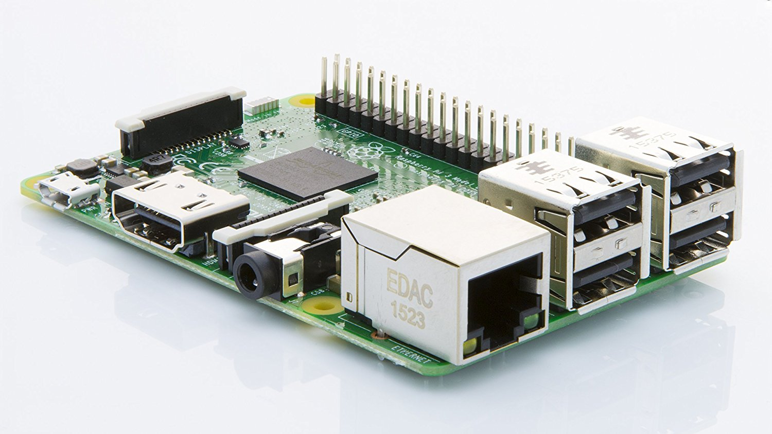







Scenario
Room Information Service
Dashboard
EnOcean
HHZ 125
Motion sensor
EnOcean
HHZ 125
EnOcean
Actions
Raspberry Pi 3
EnOcean
Recommendations via
EnOcean
EnOcean
Facility Manager
Light sensor
Temperature sensor

Slide 4
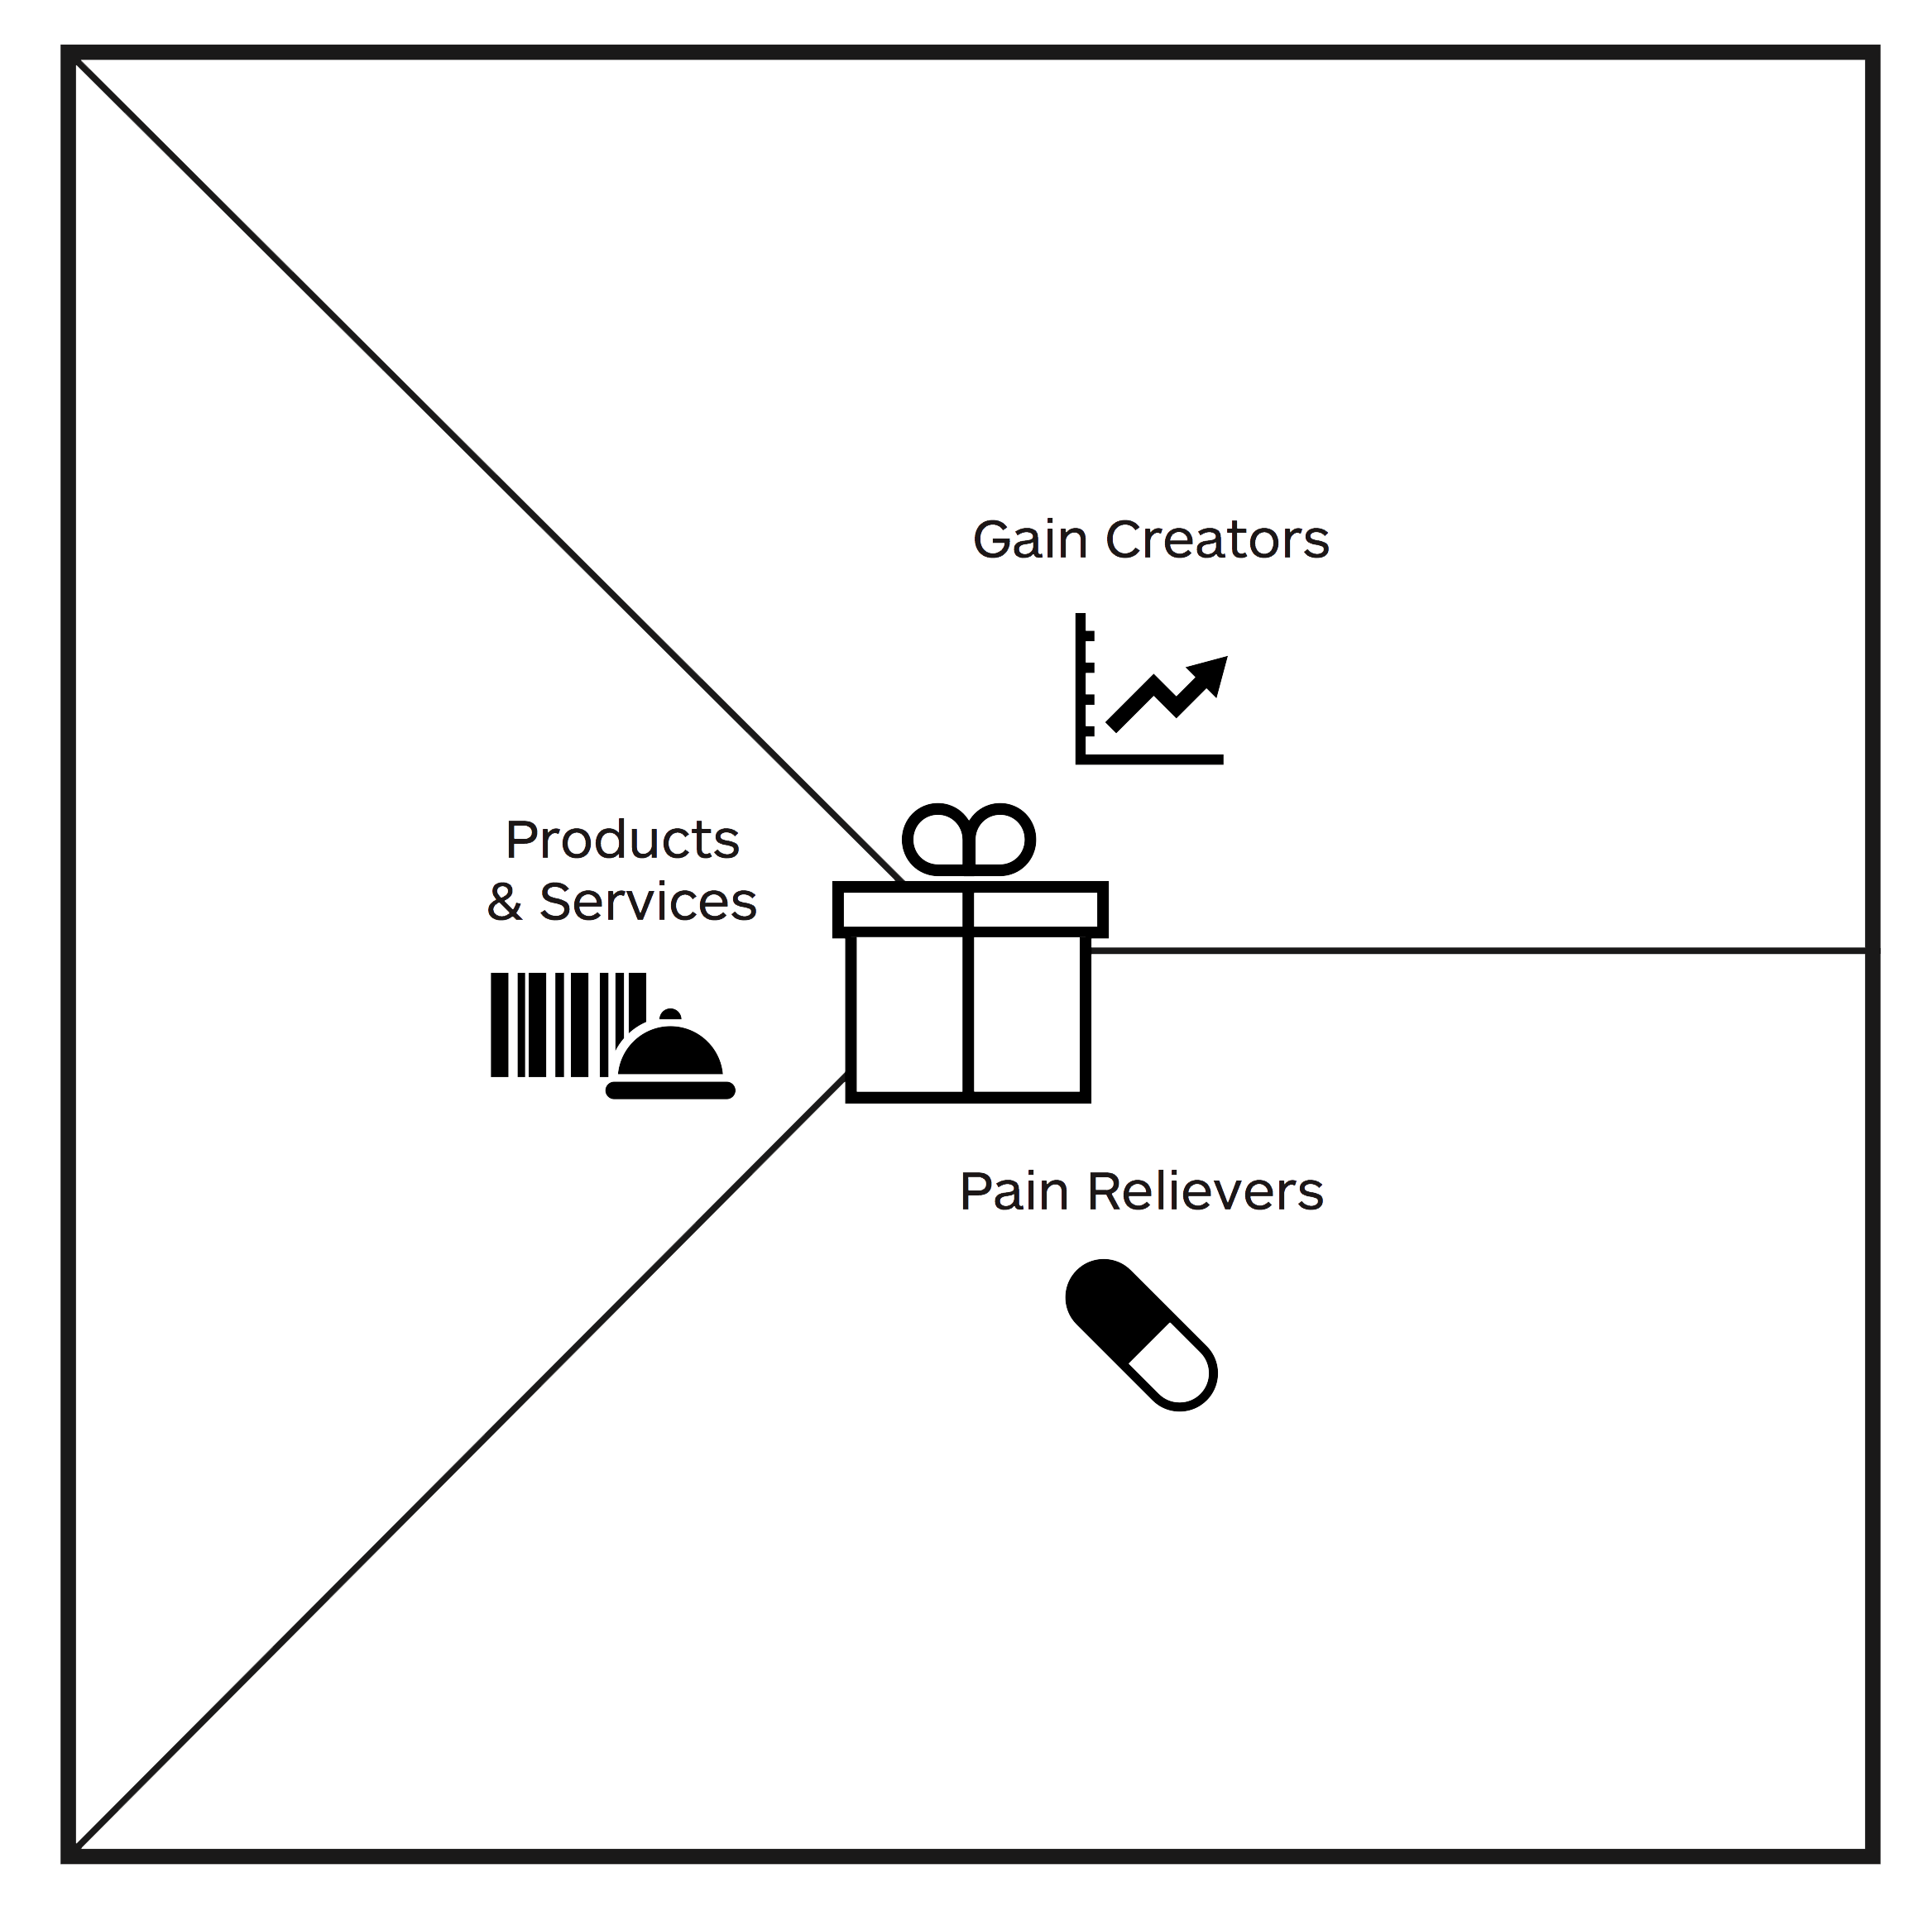
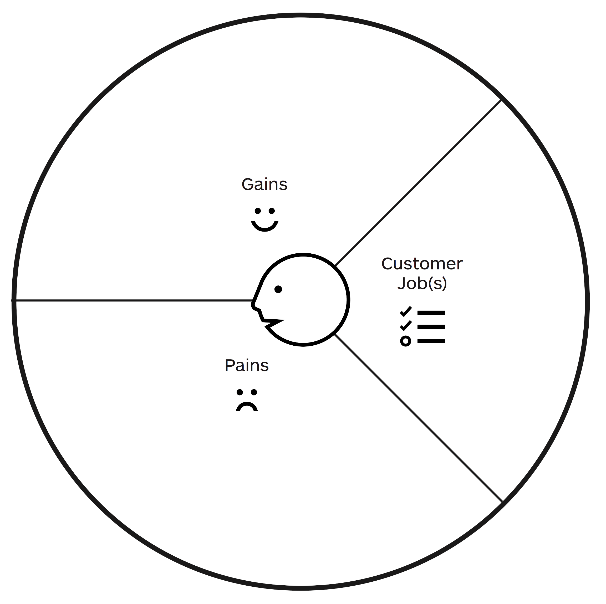
Value Proposition
Room Information Service @ HHZ for Facility Manager
Sensor information in combination with conditions gives concrete action commands or recommendations
Example: 22 am, dashboard shows open windows and no motions in room → command to close the windows
Minimum effort for manage room environment
Efficient use of energy
Reliability of closed windows and doors
Avoiding of extra work
EnOcean sensors
Raspberry Pi gateway
Dashboard providing actual status of sensors
Software commanding concrete actions in order to sensor information in combination with specific conditions
Functional: Providing a safe and energy efficient room
Emotional: Well done job
Social: Activity by given command avoid personal room checking (extra work)
Extra work (effort)
→ physical check of room environment
Unlocked rooms at night
Open windows after classes
Cold rooms
Destroyed rooms (e.g. caused by rain, snow)
Motion, light, temperature sensors and sensors at windows provide information about actual status on a dashboard
Dashboard is available at any time (mobile: App)

Slide 5

Architecture
Dashboard
E-Mail
Software Layer
Google calendar
MQTT Subscriber
(HHZ MQTT Broker)
Event Processing
(NodeJS Socket IO)
MQTT Publisher
(HHZ MQTT Broker)
Controller (Raspberri Pi 3 Model B)
Hardware Layer
Gateway (USB 300)
Window Sensor
(Wireless magnet contact STM 250 (OEM)
Temperatur Sensor
(NodOn-STP - 2-1-03 EnOcean-Sensor)
Door Sensor
(Wireless magnet contact STM 250 (OEM)

Slide 6
Live Demo

Slide 7
Questions?

Slide 8
Thank you!

